Slide 1
Real-Time Pointcloud Fusion and Mesh Generation
Remo Meyer & Jan Rüegg

Slide 2
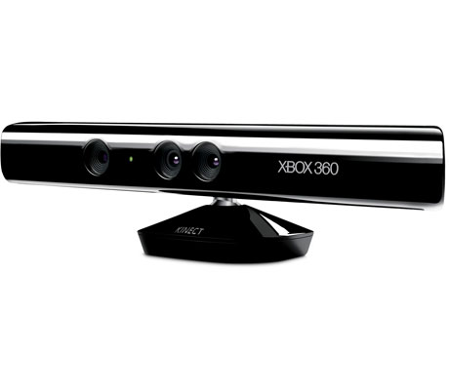
Pipeline

Slide 3
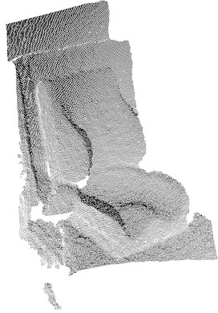
Pipeline
openni

Slide 4
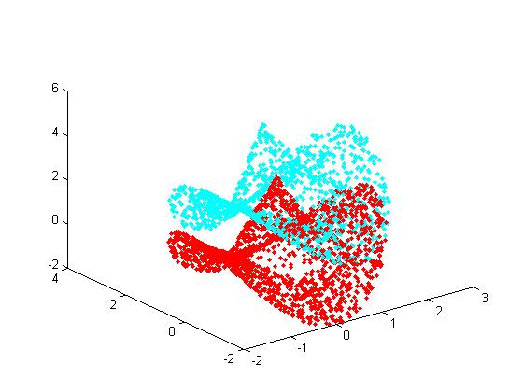
Pipeline
openni
ICP

Slide 5
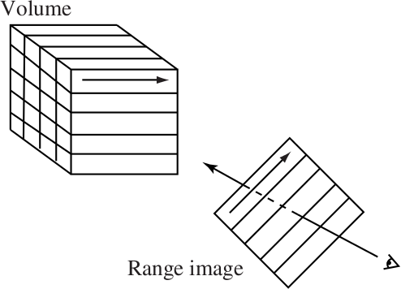
Pipeline
openni
ICP
VRIP

Slide 6
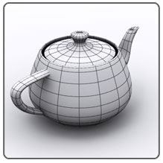
Pipeline
openni
ICP
VRIP
Marching
Cubes

Slide 7
Pipeline
openni
ICP
GPU
VRIP
Marching
Cubes

Slide 8

Part 1: ICP
3D – Photography Course
Reading Kinect Data
6-Step ICP Pipeline
Robot Operating System

Slide 9
Part 2: VRIP
A Volumetric Method for Building Complex Models from Range Images
Brian Curless & Marc Levoy, Stanford University, SIGGRAPH '96
From Scratch Implementation

Slide 10
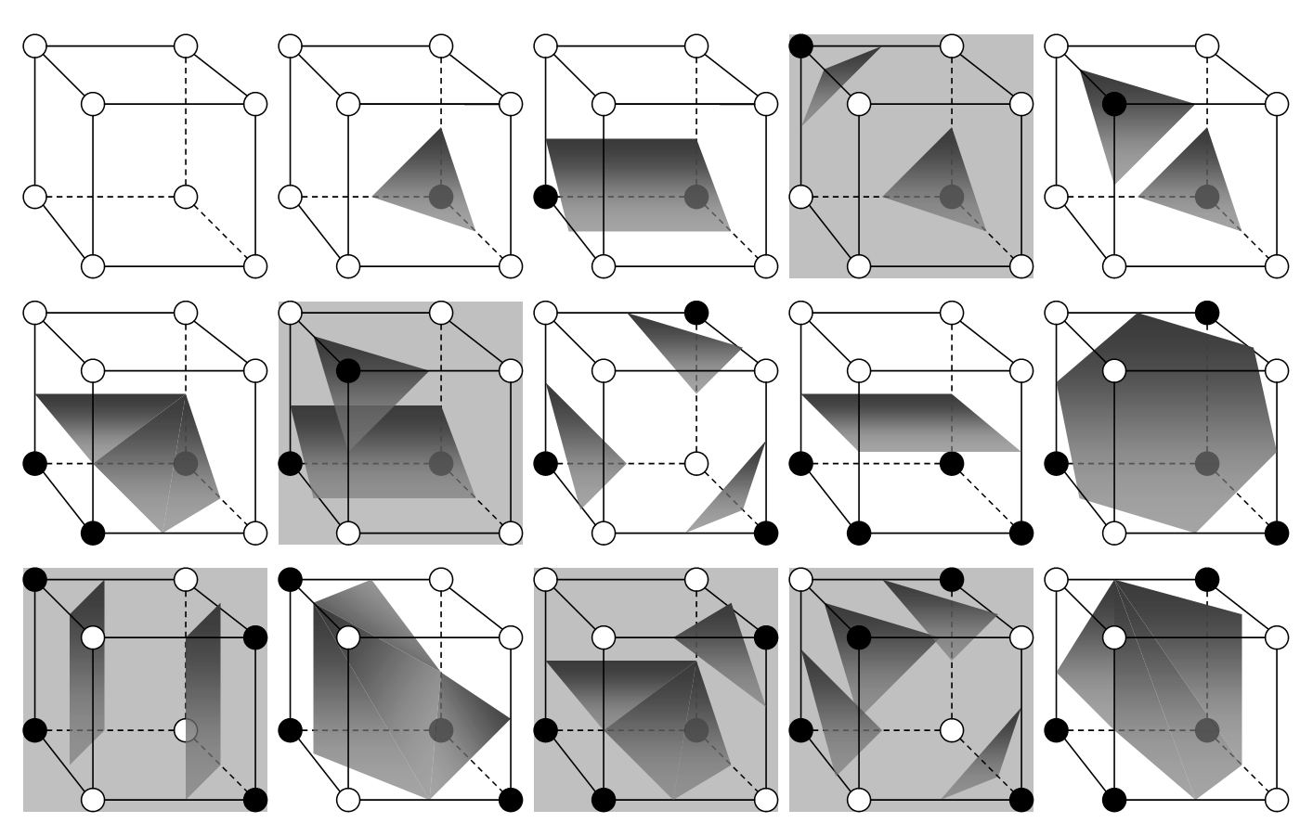
Marching Cubes

Slide 11

Marching Cubes
Reference Implementation
  http://www.thebigblob.com/tag/marching-cubes/
Ported to OpenCL
Prefix-sum to decrease memory requirement

Slide 12
Technical Details
ROS
OpenCL
Multiple Threads
  (1 for ICP, 1 for VRIP / Marching Cubes)
Realtime
Incremental

Slide 13
Setup
MacBook Pro 13“
GPU: Gforce 320M
CPU: Core2 Duo @2.4GHz
Grid Size: 128x128x128
Notes:
Limitation of graphics card... (shared ram)

Slide 14
Speedup
 | Vrip | Marching Cubes
CPU | 44.3 ms | 126 ms
GPU | 5.2 ms | 91 ms
Speedup | 8.5 | 1.38
Notes:
Vrip for each image
Marching cube once
Good, dualcore cpu, weak gpu

Slide 15
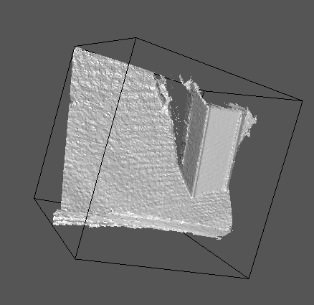
Demo!

Slide 16
Outlook
Realtime Viewer
More Memory Efficiency
Finer Volumetric Grid

Slide 17
Our Repository
https://github.com/SgtPepper123/ICP_3dPhoto
Important files in the project Folder (kinect_icp):
  src/vrip.cpp: Vrip and Marching Cubes Subscriber
  src/point_cloud_fusor.cpp: ROS interface
  fuse.cl: Vrip and Marching Cubes OpenCL Kernel
  ScanLargeArrays_Kernels.cl: PrefixSum kernel

Slide 18
Our Contribution
The PrefixSum kernel was the only thing not written by us. As we already did this task in the exercise, we did not port it to OpenCL, but used a reference implementation from the AMD SDK instead.
Also, the files mentioned above are all written entirely for this lecture. The 3d - Photography work was done in the other files (like icp_local.cpp, icp_core.cpp...)

